Slide 1
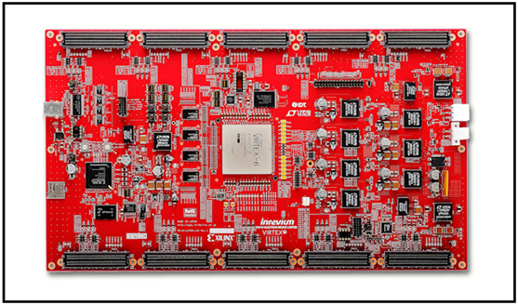
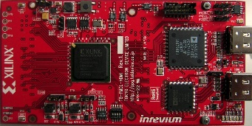
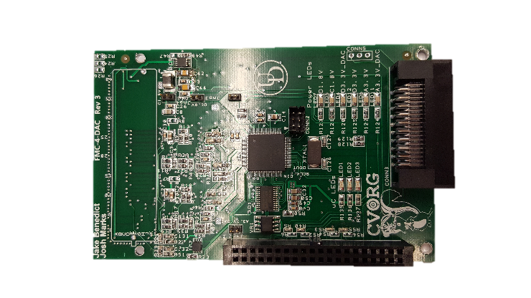
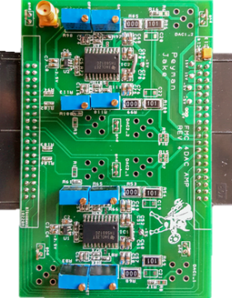
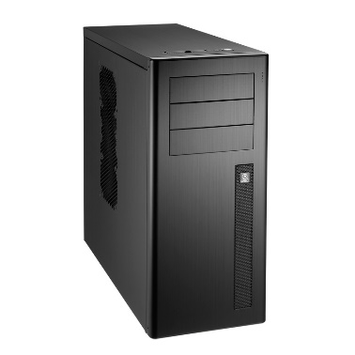
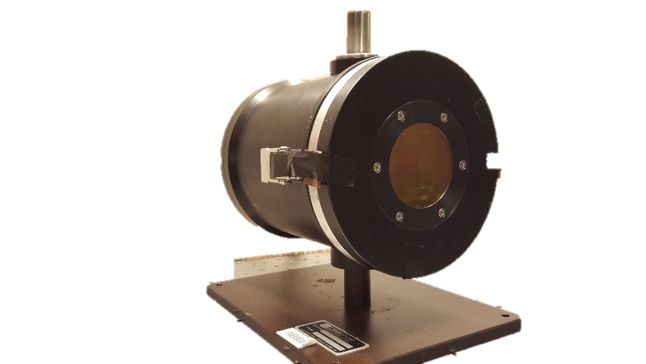
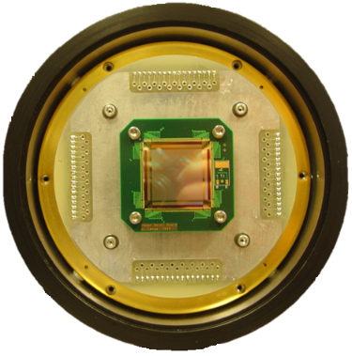
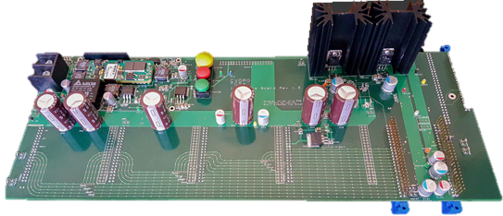
Scene Generator
System
CSE Control Box
/ NUC System
8x DAC Cards
8x Amp Cards
HDMI INPUT 2
FPGA Main Board with 10 FMC Slots
HDMI INPUT 1
Close Support Electronics
2x Interface Board
Hybrid Array
Dewar – RIIC

